Slide 1
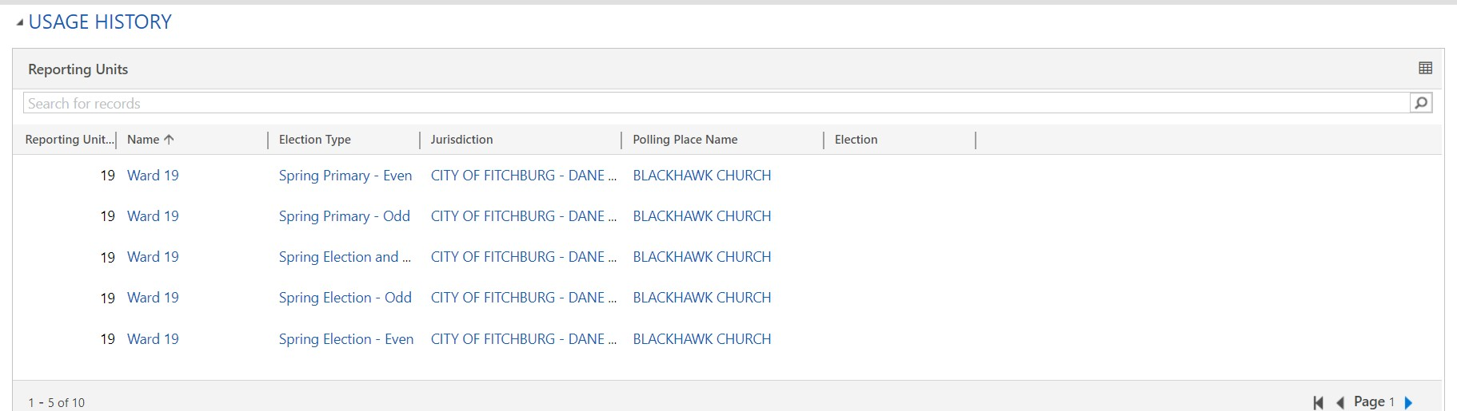
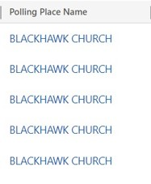
Polling Place Surveys
Polling Place Surveys
Survey Name
Election Date
11/8/2022 Blackhawk Church
8/16/2022 Blackhawk Church
4/5/2022 Blackhawk Church
2/15/2022 Blackhawk Church
4/6/2021 Blackhawk Church
2022 General Election
2022 Partisan Primary
2022 Spring Election
2022 Spring Primary
2021 Spring Election
11/8/2022
8/16/2022
4/5/2022
2/15/2022
4/6/2021
This is what it would look like on the Polling Place record screen. If you go into Polling Places tile, click on the name of a polling place and scroll down.
This view will show 5 per page, but they can page through to see the rest.
From here, if you click on the table icon in upper right, it will take you to what you see on slide 2.
From here, if you click on a Survey Name it will take you to what you see on slide 3.

Slide 2
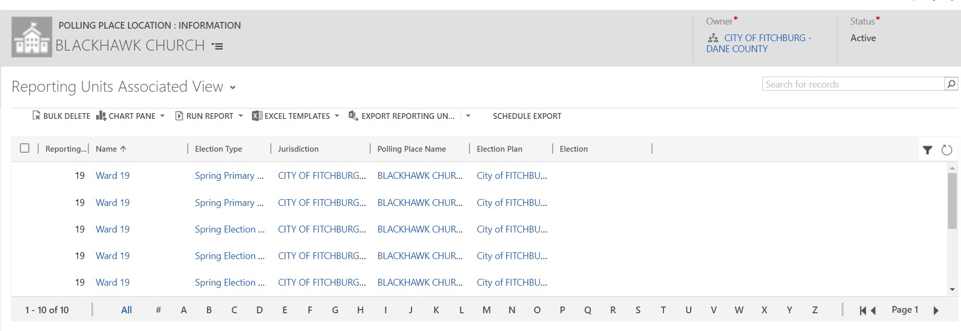
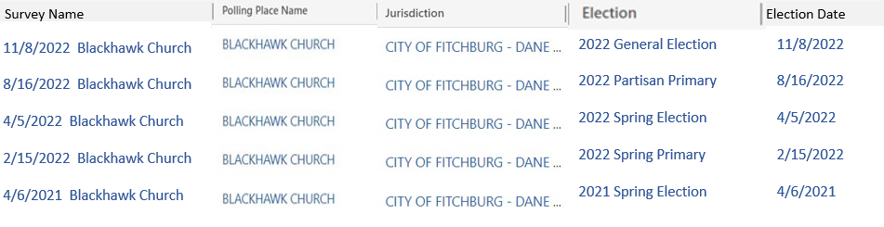
Polling Place Survey Associated View
EXPORT POLLING PL…
We come to this view by clicking on the table icon in the table seen on the polling place record (as shown in slide 1)
There can be multiple views here that show different columns of data based on what we want. Usually there is an associated view which is the default view and then maybe a view that shows inactive records of this type. To see additional views they would click on the down chevron to right of “Polling Place Survey Associated View”
In this view they can see up to 50 records on a page, but again can page through if there are more than 50 records associated.
By clicking on the Survey Name here it will take you to what is seen on slide 3, the same as if they had clicked on a Survey Name in slide 1.

Slide 3
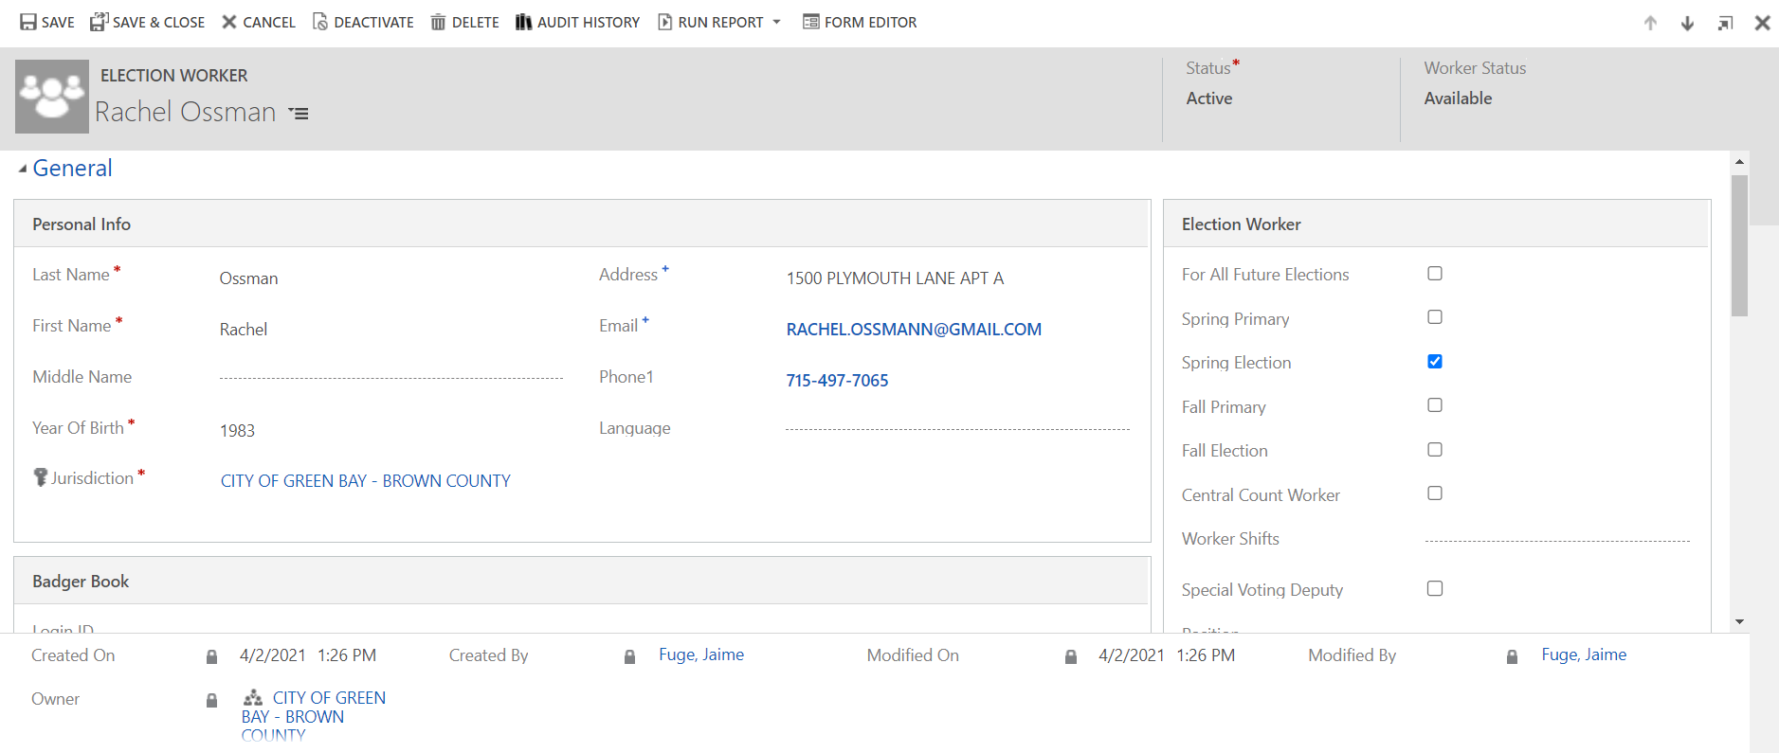
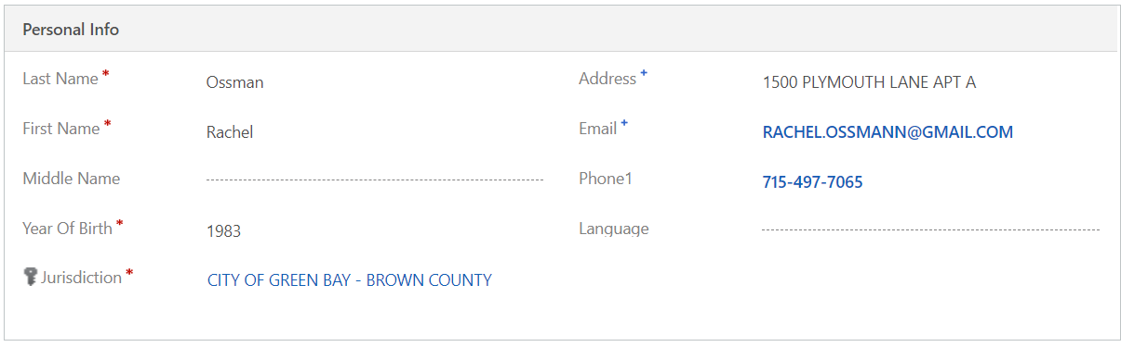
Polling Place Survey
Blackhawk Church November
Accessibility Survey
Question #
Question Text
Response
Finding
#1
Question = Question number (for state and system admins only, this will appear as a link leading to slide 4)
Question Text = Language of question
Response = Answer provided by surveyor at polling place – may be edited by Regina by clicking on question number and updating data in secondary screen (slide 4)
Finding = Finding that correlates to that question and the response provided
What should happen to question if updated response is in the positive rather than negative??

Slide 4
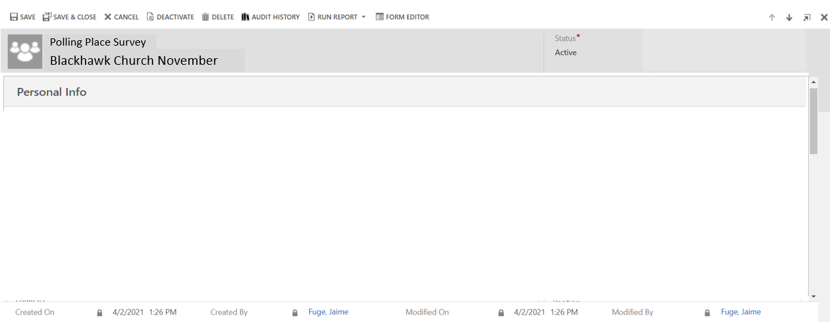
Survey Question #1
Question | Question Text | Response Provided | Response Options
1 | Is the drop-off zone, including any access aisle and/or curb ramp on firm, stable, and slip resistant ground? Note: If the surface is concrete, asphalt, tile, stone or brick, mark "Yes". If the surface is gravel, dirt, sand or grass, or if there are cracks in the surface, mark "No". | No | Yes No

Slide 5
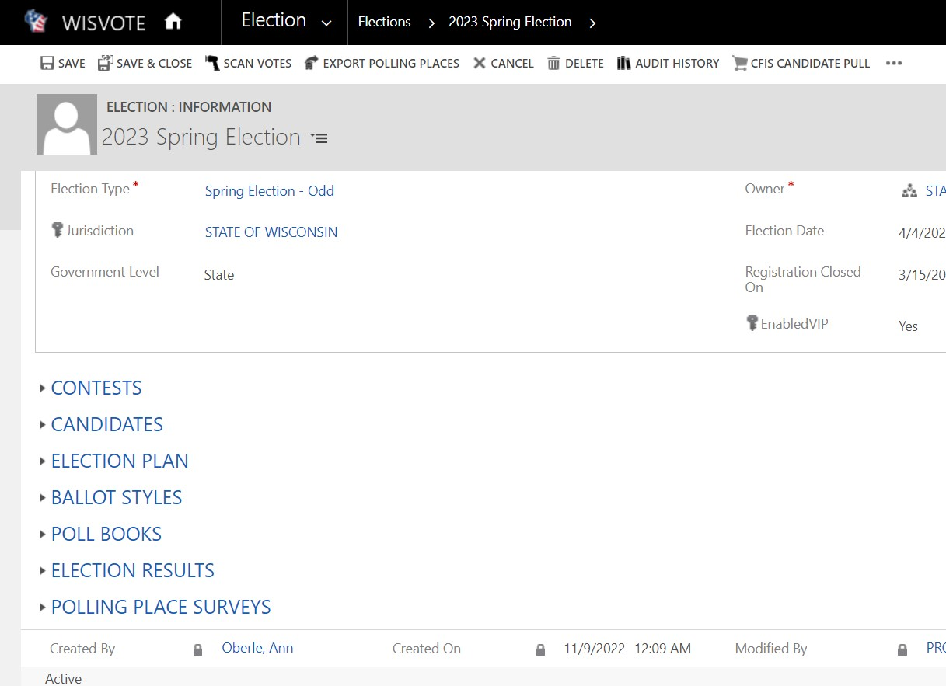
If within a specific election, if you click on Polling Place Surveys at bottom of screen it will dropdown and look like what is on the next slide

Slide 6
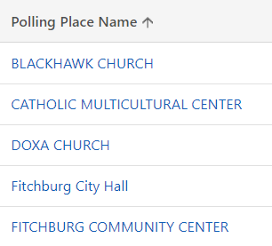
Polling Place Surveys
Polling Place Surveys
Survey Name
Election Date
BLACKHAWK CHURCH 11…
CATHOLIC MULTICULTUR…
DOXA CHURCH 11/8/2022
FITCHBURG CITY HALL 11…
FITCHBURG COMMUNITY…
2022 General Election
2022 General Election
2022 General Election
2022 General Election
2022 General Election
11/8/2022
11/8/2022
11/8/2022
11/8/2022
11/8/2022
This will appear similar to what you will see under Polling Place Surveys in a Polling Place record, only here you will see all polling places that were surveyed for that election in that municipality, one record for each.
This view will show 5 per page, but they can page through to see the rest.
From here, if you click on the table icon in upper right, it will take you to what you see on slide 7
From here, if you click on a Survey Name it will take you to what you see on slide 3.

Slide 7
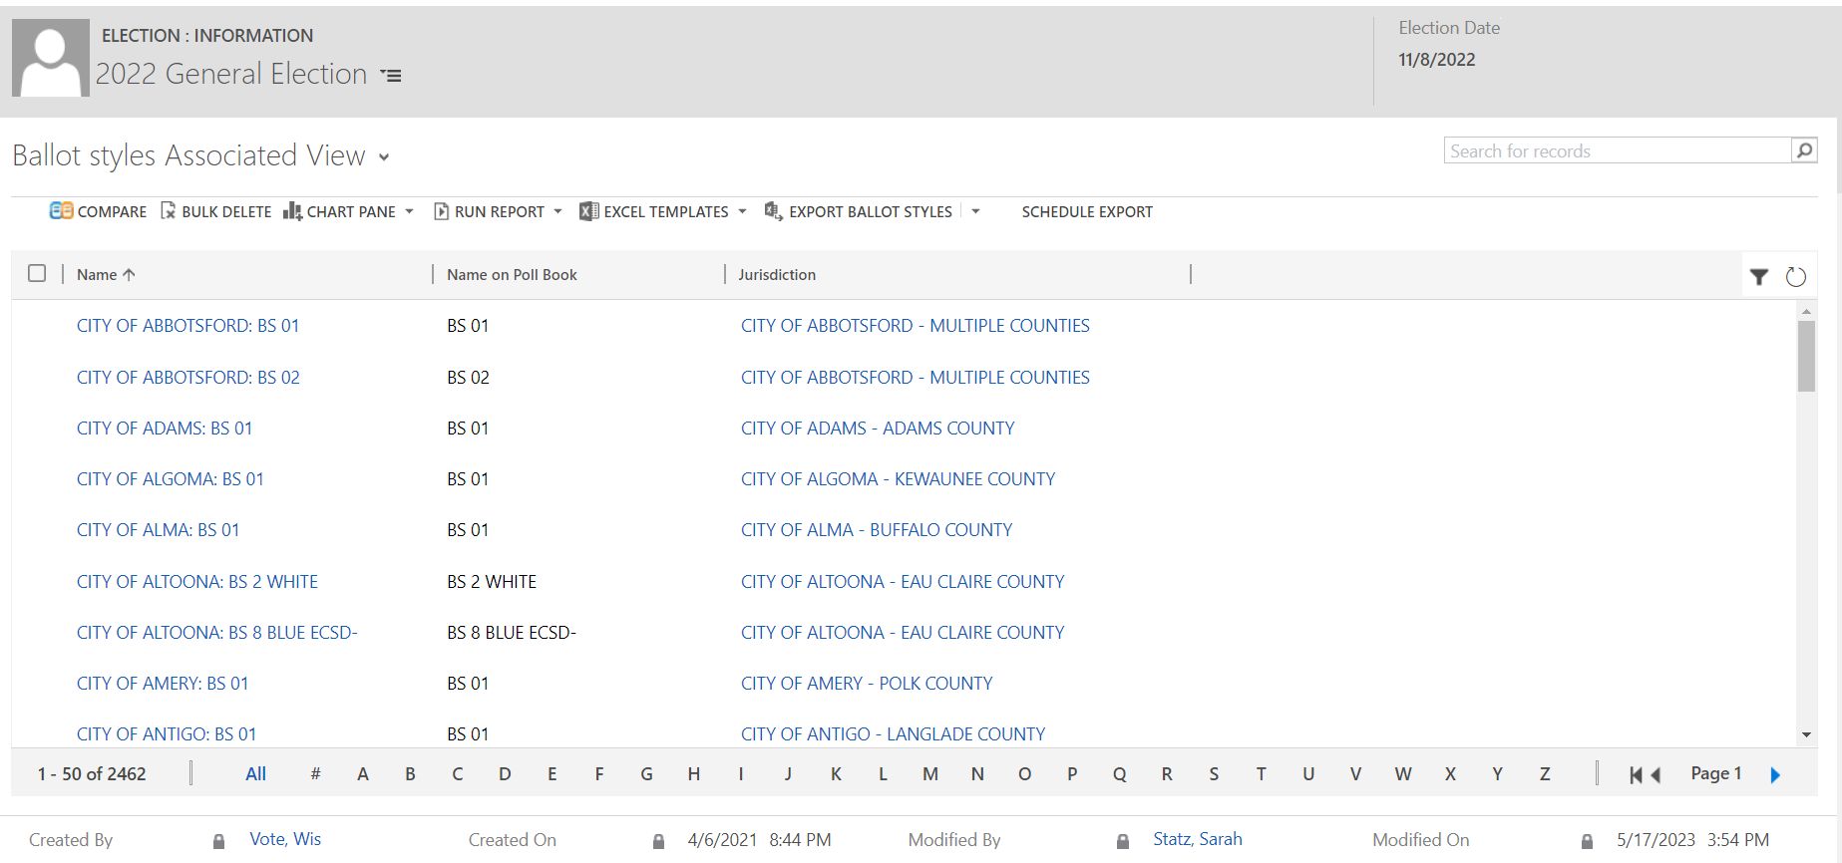
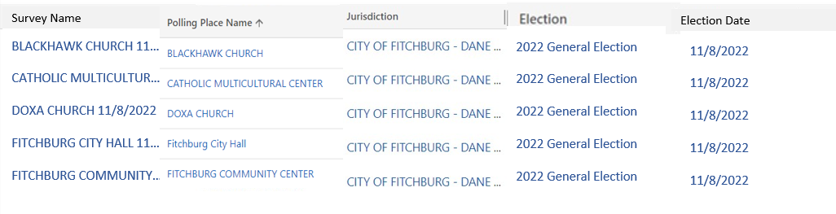
Polling Place Surveys Associated View
EXPORT POLLING PL…
We come to this view by clicking on the table icon in the table seen on the polling place record (as shown in slide 6)
There can be multiple views here that show different columns of data based on what we want. My thought is the default associated view would show just that municipalities records associated to that polling place. But the next two slides will show other views we may want as well.
In this view they can see up to 50 records on a page, but again can page through if there are more than 50 records associated.
By clicking on the Survey Name here it will take you to what is seen on slide 3, the same as if they had clicked on a Survey Name in slide 6.

Slide 8
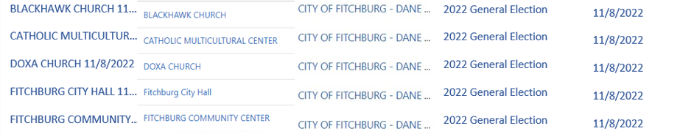
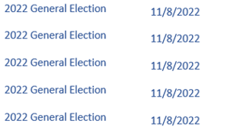
Polling Place Surveys County View
EXPORT POLLING PL…
MADISON LIBRARY 11/8..
CROSS PLAINS LIBRARY…
DANE LIBRARY 11/8/20..
MADISON LIBRARY
CROSS PLAINS LIBRARY
DANE LIBRARY
CITY OF MADISON – DANE…
VILLAGE OF CROSS PLAINS..
VILLAGE OF DANE – DANE…
We come to this view by clicking on the table icon in the table seen on the polling place record (as shown in slide 6) and then clicking on the dropdown to the right of Polling Place Surveys Associated View
I am imagining we create this view so the county users can see all of the ones done within their county for a specific election. Technically any clerk user would be able to see this, but since everything will not be editable by non-state users, that is fine.
In this view they can see up to 50 records on a page, but again can page through if there are more than 50 records associated.
By clicking on the Survey Name here it will take you to what is seen on slide 3, the same as if they had clicked on a Survey Name elsewhere.

Slide 9
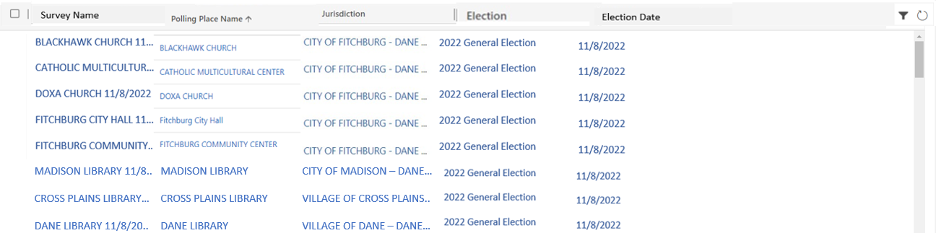
Polling Place Surveys - All
EXPORT POLLING PL…
We come to this view by clicking on the table icon in the table seen on the polling place record (as shown in slide 6) and then clicking on the dropdown to the right of Polling Place Surveys Associated View
I am imagining we create this view so the state users can see all surveys done within a specific election. I believe we can make this a view that only state users can see but technically even if any user is able to see this it should be fine since everything is not be editable by non-state users.
In this view they can see up to 50 records on a page, but again can page through if there are more than 50 records associated.
By clicking on the Survey Name here it will take you to what is seen on slide 3, the same as if they had clicked on a Survey Name elsewhere.

Slide 10
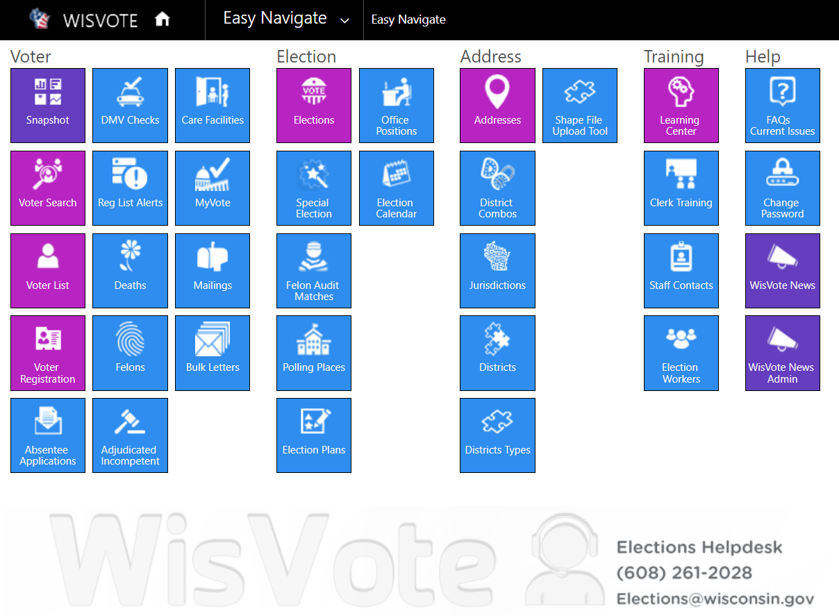
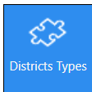
Create a new tile called Accessibility where the following will live:
Template
Tile and everything inside only viewable by State and System Admin
Accessibility

